Slide 1




Foreign Direct Investment Analytics
Presented by
Archana G

Slide 2
Introduction
Investment is a game of understanding historic data of investment objects under different events but it is still a game of chances to minimize the risk we apply analytics to find the equilibrium investment. To understand the Foreign direct investment in India for the last 17 years from 2000-01 to 2016-17. This dataset contains sector and financial year-wise data of FDI in India Sector-wise investment analysis Year-wise investment analysis.

Slide 3
01. Sector
Details of Data
02. Year

Slide 4

Main KPIs
Top 10 sectors with highest FDI value
Top 10 sectors with lowest FDI value
Most Variation in Sectors
Forecast
Proportion
Trend of Investments over the years
High growth/decline FDI in 5yrs
Groups/Sector comparison
Tableau link: https://public.tableau.com/app/profile/archana.gowda/viz/FDI_DataScienceAnalysis/FDISummary?publish=yes

Slide 5
My Design

Slide 6
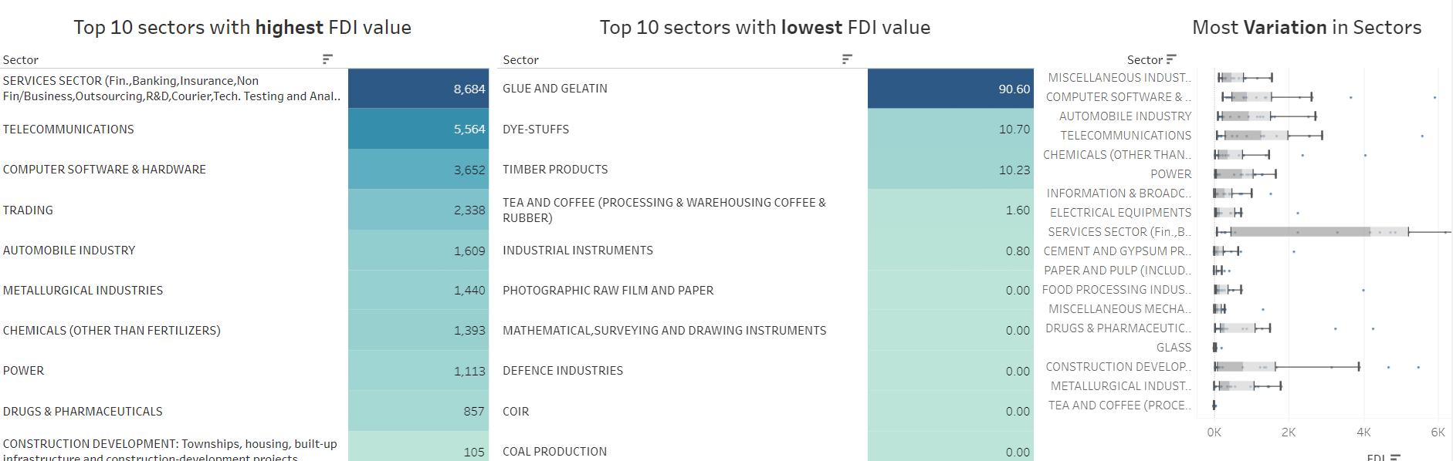

Slide 7
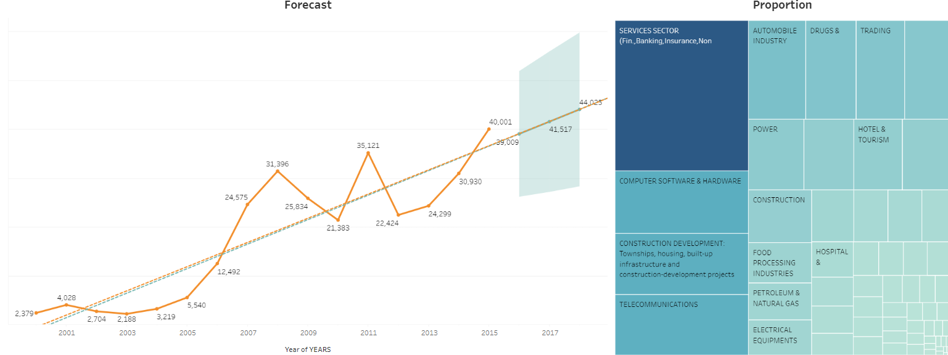

Slide 8
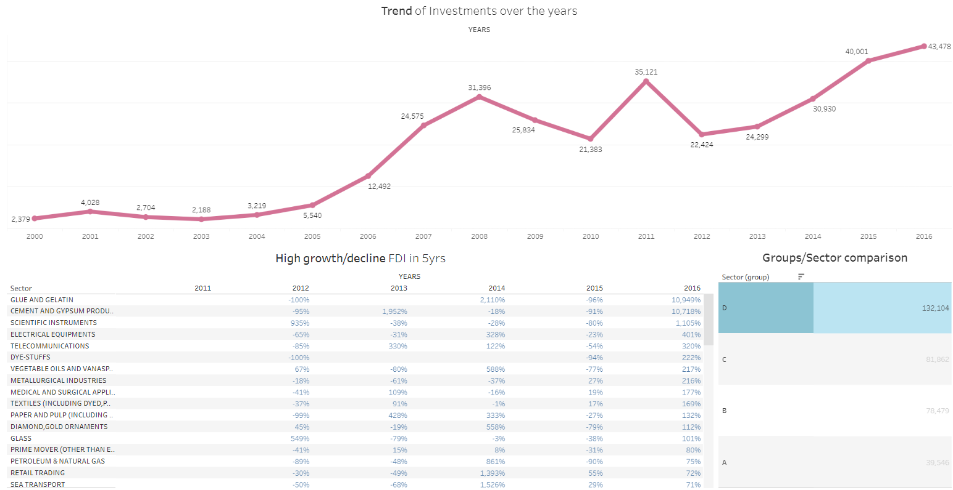

Slide 9
Thank you very much!
Presented by
Archana G
9108468992
archanagajendra22@gmail.com

